Slide 1
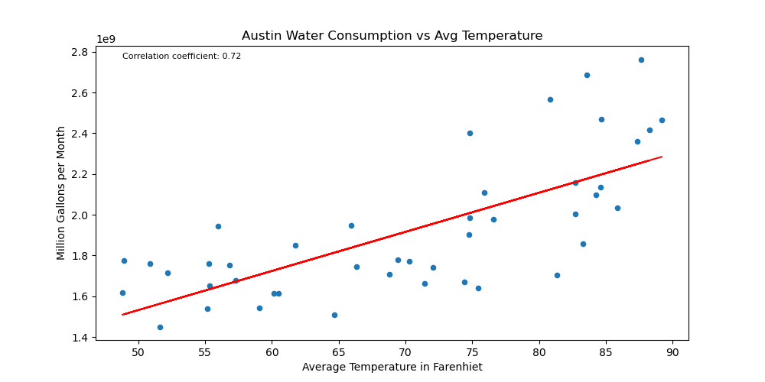
Research question 1:
Is there a relationship between average monthly water usage in Austin and temperature variation?
Analysis and calculation results:
Correlation coefficient: 0.72
p-value: 2.8001668828740518e-08
Findings:
Strong positive correlation between average temperature and monthly water consumption.
As the average temperature increases, monthly water consumption tends to increase.

Slide 2
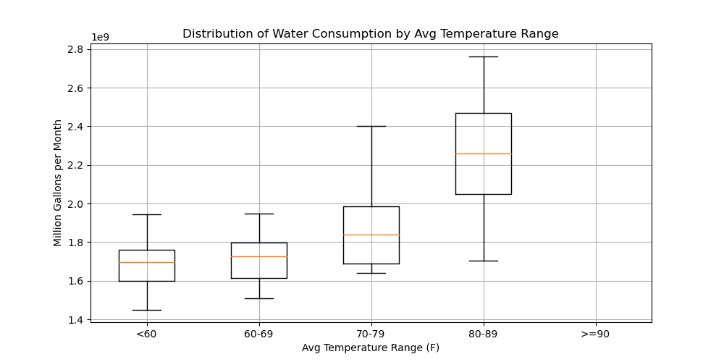
Additional insights:
Box plot analysis shows that median water consumption tends to increase as the temperature ranges become higher, indicating a positive relationship between temperature and water consumption.
Conclusion:
As the average temperature rises, an increase in monthly water consumption can be expected.
The relationship is unlikely to be a coincidence.
Limitations:
Other factors, such as city growth, were not considered in the analysis

Slide 3
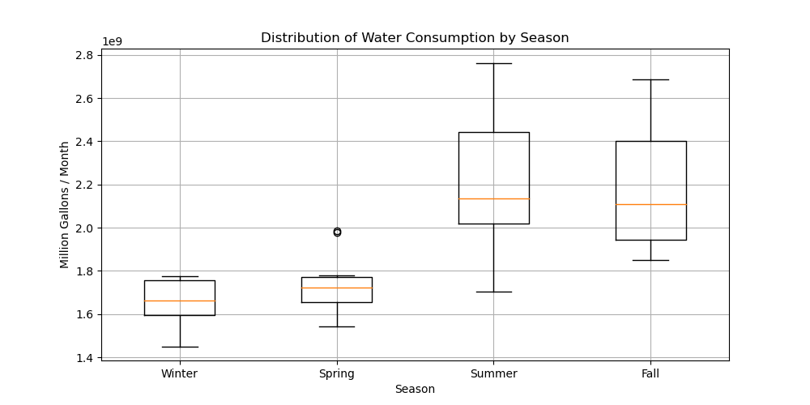
Research question 2
How does water usage change throughout the year across different seasons?
Findings:
Scatter plot and boxplot observations:
Higher average monthly water consumption during Summer and Fall seasons.
Lower average monthly water consumption during Spring and Winter seasons.
Highest average water consumption observed during Summer, while the lowest occurs during Winter.

Slide 4
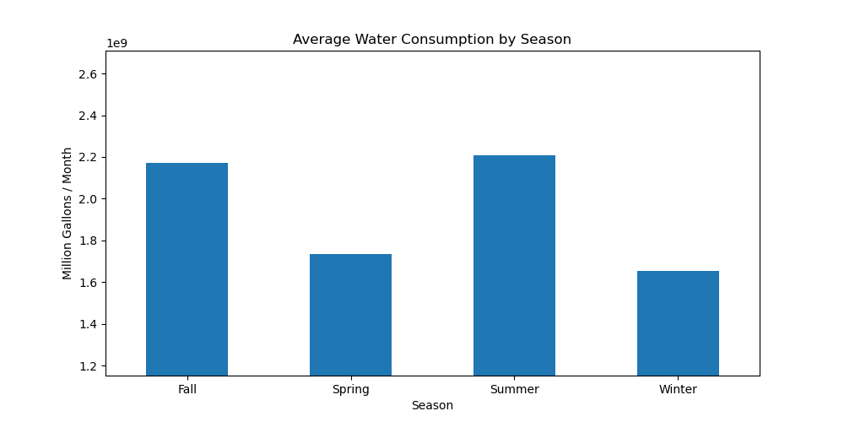
Conclusion:
Seasonal influence on water consumption is evident.
Water usage is higher during the Summer and Fall seasons compared to Spring and Winter.

Slide 5
